Slide 1
Modern College of Arts,Science & Commerce
Wireless securitymanagemet system
By-
Abhishek Digambar Hirve RollNo:-32021

Slide 2
Agenda
System Overview
Technologies Used
Problem definition
Limitation of manual system
Proposed System
Design Specification
Input screen
Features of the System
Limitation
Future Enhancements
Challenges

Slide 3
SystemOverview
This system is used in various defence system in Indian Government and worldwide.
Recently this system is used in State Police Department for communication between various operations and digital connectivity.
This system is used in signalling department in army in filt tactics called as Field Martial.

Slide 4
Technologies Used
Computer Systems :DDR2RAM
Processor : Pentium
OS : Windows XP
Access : Ms Access
Software : Visual Basic 6.0

Slide 5
ProblemDefinition

Slide 6
Problem Definition (Continued..)

Slide 7
Limitation Of The Manual System
NEED OF SOFTWARE SPICIFIATION.
NED AN VB6.0 COMPATIBAL MATCHINES.
WORKS WIT ACCESS DB.
ONLY SATTIC ENTRIES ARE POSSIBLE.
CONFIDENTILITY NEED TO BE MAINTAIN FoR ACTIVITY RECORD BECAOUSE OF CONFIDENTIAL DATA ENTIES ARE INCLUDED.

Slide 8
Proposed System
This system will help to maintain records for different offices which are linked together in defence system.
It will help to manage financial records and transactions of various offices.
It will help in consistency of equipments which are required and operations information.
It will generates various reports for different different modules.

Slide 9
List of Processes within the System
Equipmentselection:For events,operations,repairing.
Allotment:alloted to employee.
New orderiong equipments.
New office:registration
Sattlite :launching detailing,equipselection,getting.
Rocket: detailing,equipselection,getting
New Frequency:registration
REPORTING& BILLING:TO GOVERNMENT OF INDIA

Slide 10
Design Specification

Slide 11
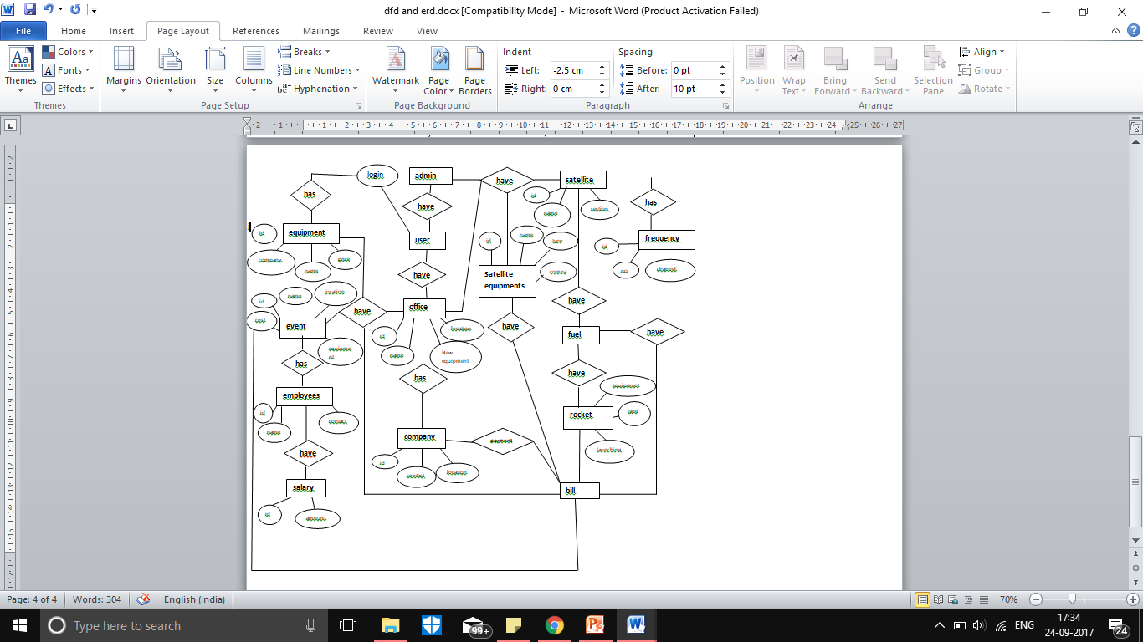
E R Diagram

Slide 12
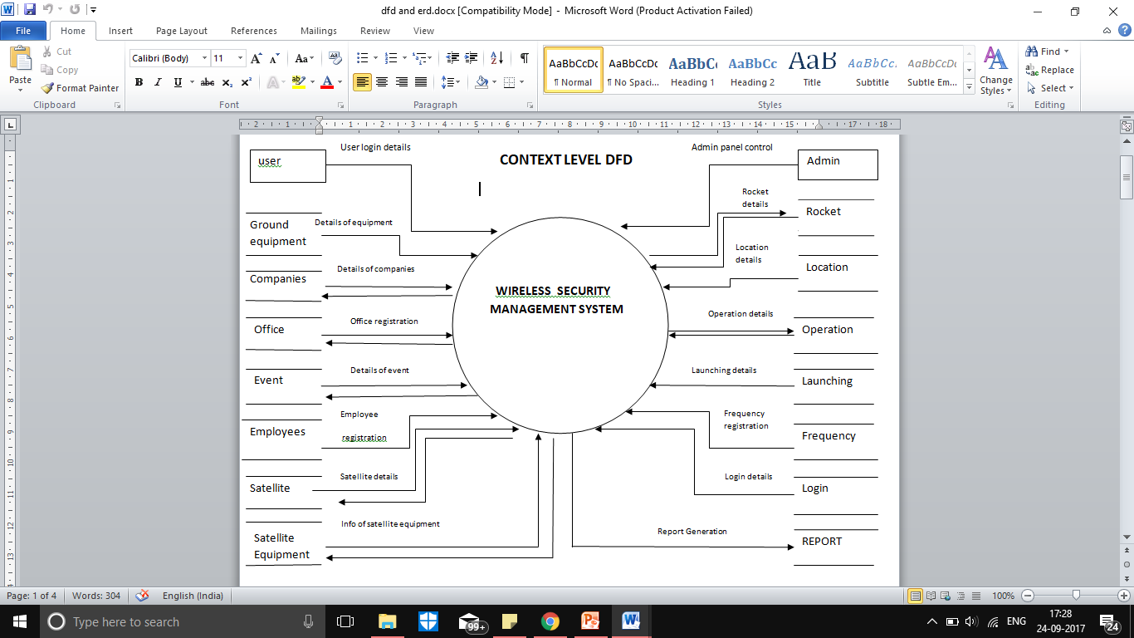
Context level DFD’s

Slide 13
First Level DFD

Slide 14
Features of System
SYSTEM WILL HELP TO MAINTAIN VERIOUS GOVT.ACTIVITIES OR OPERATIONS.
SYSTEM IS YOUSED WORLD WAIDLY AS MAINTAIN AN CONFIDENTIAL COMMUNICATION FOR VERIOUS ACTIVITIES.
THE SYSTEM MAINTAIN AN COLLABORATION BETWEEN ACTIVITIES AND REQUIREMENT MAINTANANCE.

Slide 15
Limitation Of the System
THE BIGGEST LIMITATION OF SYSTEM IS IT WILL BE AN STATIC SYSTEM.
WORK ONLY FOR OFFICE LEVEL.
IT WILL NEED AN NETWORK CONNICTIVITY TO BE AN GLOBAL.
THE SYSTEM WILL PROVIDE ONLY RECORRDING OF AN PHYSICAL ACTIVITY IN WORK ENVOIRNMENT OF OFFICES.

Slide 16
Future Enhancement
This System will be used as dynamic system to connect various offices and operation by using World Wide Network.
It will help to maintain spectrum wise satellite network distribution and cost management to authority.
This system will help to maintain in advance stage of the system in world of digitalisation in defence communication system.

Slide 17
Challenges
THE BIGGEST CHALLENGE IS THE SYSTEM WILL WORK ONY STATIC OPERATION MAINTANANCE.
LACK OF COMMUNICATION .
LACK OF DIGITALLY STATEMENTS TRANFER BY USING SYSTEM BASED PLATFORM ONLY
IT WILL BE NOT POSSIBLE WITHOUT NETWORK ATTACHMENT.

Slide 18
THANK YOU

